Slide 1
Abortion Access and Crime
Jack Perkins

Slide 2
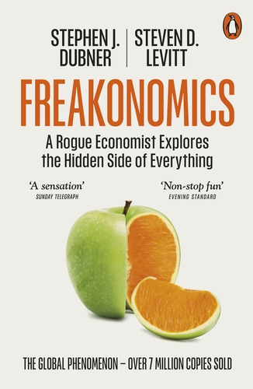
The Original Question
In Freakonomics (and accompanying papers), the authors proposed an alternate theory on the crime crash of the 1990s
Experts attributed it to the economy, innovative policing styles, and other policy changes
Instead, the authors offered that it may have been the Roe v Wade decision 20 years earlier

Slide 3
Methodology
Clear inflection point (country wide legalization)
Some states legalized sooner
Compare the crime rates and drop offs in these earlier states vs later states
Controlled for various factors
Policing levels
Economic conditions

Slide 4
Results
Found that states with earlier legalizations did see earlier drops in crime
Creates a link between unwanted pregnancy abortion rates and crime
Unwanted pregnancy abortion rates assumed to be linked to legal abortion access
Comes to conclusion that access to legalized abortion may result in lower crime rates

Slide 5
My Question
Do these conclusions hold today?
This could be especially important with the reversal of the Roe decision

Slide 6
Planned Parenthood v. Casey (1992)
Lightened scrutiny on abortion laws
Can not create “undue burden”
More restrictive laws
Waiting periods
Parental consent
Undid equal access of the Roe era

Slide 7
Collecting Data
Variables of Interest
Abortion rates over space and time
Global Abortion Incidence Dataset
Crime rates in the 18-25 year later period
Unified Crime Reporting Statistics
Abortion Policy Scores
Guttmacher Policy Scores
Control Variables
Unemployment rates
Bureau of Labor Statistics
GDP
Bureau of Economic Analysis
Demographic data
US Census

Slide 8
Basic Model Design
Two-Way Fixed Effects Linear Regression
Fixed Effects
State Effects
Holds constant stable differences across time
Time Effects
Holds constant stable differences across time
Regression
Use abortion rates to predict violent crime rates 18-25 years later

Slide 9
Immediate Issues
Creating the lagging crime variable
About 10% of years are missing data
Would not be able to use all years
Solution – create a 5-year average crime variable
Used to capture range of years and prevent missing values
Demographic data restrictions
Only present from 2010 on
Solution – a second model to focus on these effects

Slide 10
Standard Model
Pure prediction using full range of years
Omits demographic data
Variable | Coefficient | P-Value
Abortion exposure | 5.404* | 0.052
Unemployment Rate | 3.808 | 0.427
GDP | -0.000 | 0.246

Slide 11
Robust Model
Utilizes demographic data as controls
Uses only crime lag data from 2010-2019
Variable | Coefficient | P-Value
Abortion exposure | 2.079 | 0.182
Unemployment rate | 9.261** | 0.041
GDP | -0.000 | 0.618
Population age 18-24 | 22.201 | 0.241
Bachelor’s degree or higher | -10.760* | 0.073

Slide 12
Weighted Model
Omits demographic data
Places weight on crime lag data
If there are more observations in the averaged period, the observation is given more weight
3 observations in a 5-year period will have more say than 1
Variable | Coefficient | P-Value
Abortion exposure | 5.019* | 0.066
Unemployment Rate | 7.000 | 0.146
GDP | -0.000 | 0.343

Slide 13
Comparing Models
Model | Pros | Cons
Standard | -Uses full data set | -Overrepresents small lag samples
Robust | -Uses census data for controls | -Cuts observations in half
Weighted | -Reduces overrepresentation
The weighted model provides a more balanced view while not sacrificing any observations.

Slide 14
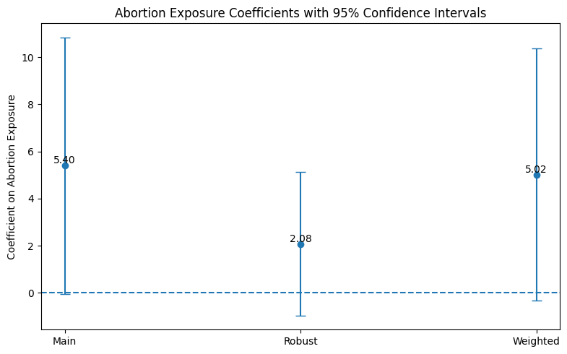
Interpretation: A coefficient of 5 means an increase in one abortion per 1000 women increases crime by 5 per 100,000

Slide 15
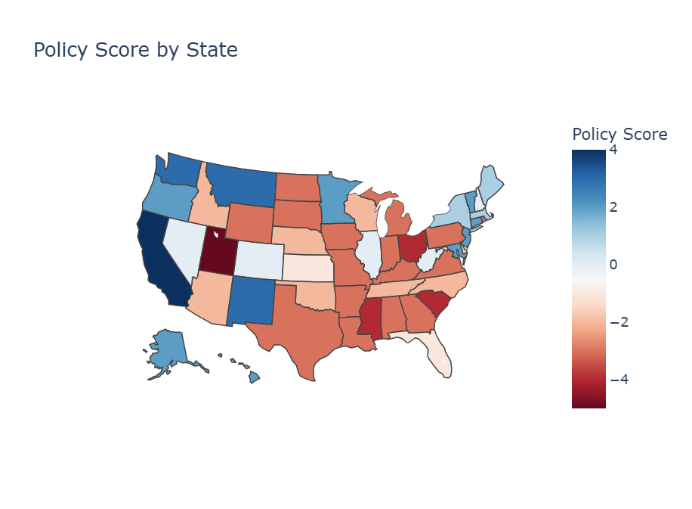

Slide 16
Policy Score Models
Separate Models
Introduces policy score variable
Runs separate regressions for states with weak and strong restrictions
Interaction Model
Measures if policy score changes the size/significance of the effect
Fewer Restrictions
Stronger Restrictions
Variable | Coefficient | P-Value
Abortion exposure | -5.185 | 0.197
Unemployment Rate | 9.285 | 0.219
GDP | -0.000* | 0.083
Variable | Coefficient | P-Value
Abortion exposure | 8.562*** | 0.000
Unemployment Rate | -0.805 | 0.883
GDP | -0.000 | 0.153

Slide 17
Policy Score Models (continued)
Interaction Model
Variable | Coefficient | P-Value
Abortion exposure (weak restrictions) | 7.442*** | 0.000
Exposure x High Restrictions | -9.644*** | 0.001
Unemployment Rate | 3.069 | 0.468
GDP | -0.000** | 0.032
Interpretation: There is a significant difference in the relationship between abortion and crime dependent on the surrounding policy environment.

Slide 18
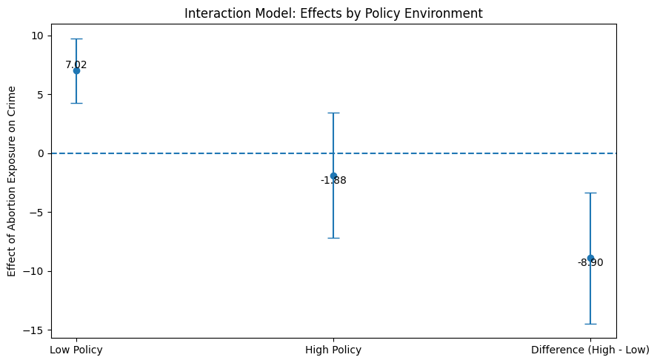

Slide 19
Results
There is some evidence to suggest that abortion rates could be correlated with lagged crime rates
Any relationship is small and would only be impactful with big swings
The found relationship is the opposite of Levitt’s, with a positive relationship between the two variables
There is a significant difference in the relationship depending on the policy environment
This backs the finding of Levitt that the legality of abortion has affects on crime

Slide 20
Possible Theoretical Explanations
Casey vs Roe
Casey created less impact on access than Roe did
As such, the effects on rates and violent crime are expected to be smaller
Does not explain why the coefficient is positive
Rise of Contraceptives
Abortion rates fell across the US regardless of policy changes
Increased contraceptive access concentrated abortion to lower income individuals
Abortion may now be a stronger proxy for socioeconomic status
If true, abortion rate correlates more strongly with violent crime rates

Slide 21
Limitations
Incomplete data hurts the ability to make conclusions
A more complete crime set would allow for true rolling averages
Crime data is not readily available on just the 18-25 age group
Effects would be primarily concentrated on this group
Census data was not easily accessible for before 2010
Using demographic data for controls requires cutting half of the observations

Slide 22
Conclusions
This study provided both a reinforcement and rebuke of Levitt
It was unable to replicate a significant and negative relationship between abortion exposure and lagged crime rates
It was able to provide some link between abortion policy and the strength of this relationship
Supports that abortion policy and therefore access could have impacts on crime
A study with a more complete data set could potentially produce more certain and significant results

Slide 23
Further Study
Effect of Dobbs
Expected to be much greater than Casey
Could create grounds for significance and real-world impact
Contraceptive access as a predictor
Contraceptive use may be the “new abortion” in preventing unwanted pregnancy
Access to contraception could be the better predictor

Slide 24
Bibliography
Bureau of Economic Analysis. (n.d.). Interactive data tables. Retrieved April 11, 2026, from https://apps.bea.gov/itable/
Bureau of Labor Statistics. (n.d.). State unemployment rates (LAU series). Retrieved April 11, 2026, from https://www.bls.gov/lau/rdscnp16.htm
CORGIS Dataset Project. (n.d.). State crime dataset. Retrieved April 11, 2026, from https://corgis-edu.github.io/corgis/csv/state_crime/
Donohue, J. J., & Levitt, S. D. (2001). The impact of legalized abortion on crime (Working paper). University of Chicago. https://pricetheory.uchicago.edu/levitt/Papers/DonohueLevittTheImpactOfLegalized2001.pdf
Federal Bureau of Investigation. (n.d.). Crime Data Explorer. Retrieved April 11, 2026, from https://cde.ucr.cjis.gov/LATEST/webapp/#/pages/home
Guttmacher Institute. (2020, January 24). State abortion policy landscape: Hostile and supportive states. https://www.guttmacher.org/sites/default/files/article_files/hostile_and_supportive_state_abortion_laws_1-24-2020.pdf
Inter-university Consortium for Political and Social Research. (n.d.). Arrests by age, sex, and race dataset. Retrieved April 11, 2026, from https://osf.io/kthnf
Levitt, S. D., & Dubner, S. J. (2005). Freakonomics: A rogue economist explores the hidden side of everything. William Morrow.
Oyez. (n.d.). Planned Parenthood of Southeastern Pennsylvania v. Casey. Retrieved April 11, 2026, from https://www.oyez.org/cases/1991/91-744
Planned Parenthood Action Fund. (n.d.). Roe v. Wade: Behind the case that established the legal right to abortion. Retrieved April 11, 2026, from https://www.plannedparenthoodaction.org/issues/abortion/roe-v-wade/roe-v-wade-behind-case-established-legal-right-abortion
U.S. Census Bureau. (n.d.). Age, sex, education, income, and race data tables. Retrieved April 11, 2026, from https://data.census.gov/

